Slide 1

An innovative urban policy:
The Payment for Insufficient Density (PID)
Vincent Viguié (CIRED)
Paolo Avner (CIRED/World Bank)
Stéphane Hallegatte (World Bank)
Avner, Viguié, and Hallegatte. 2013. “Modélisation de l’effet d’une taxe sur la construction.” Revue de l’OFCE N° 128 (2): 341–64.
Avner, Viguié, and Hallegatte. 2014. “When taxing construction leads to more construction: modelling the impact of a land value tax on low density”. To be published

Slide 2

Payment for Insufficient Density (from mid 2012 onwards in France)
Part of French law (introduced in 2010 budget)
  Objective: Limit urban sprawl and promote a less extensive usage of land
  Each mayor can tax new developments with insufficient density
  define Minimum Density Thresholds (MDT): housing surface / land lot surface
  It applies to construction permit holders
PID is calculated as:
  Half the m² ground land value x the missing housing surface so that the building reaches the Minimum Density Threshold
  Cannot exceed 25% of the land’s value
Notes:
What are the impacts of a Payment for Insufficient Density?

Slide 3
Implementation example
  Cannot exceed 25% of the land’s value
Project: construction of a house of 160m²
  Land lot: 800m², value 140 000€
  MDT= 0.6
MDT= 0.6 corresponds of housing surface area 480m² (SMDT)
  PID= 140000/2 * (480m²-160m²)/480m² = 46 666€
However the PID cannot exceed 25% of the land’s value which amounts to 35 000€
➔ Therefore, the building permit holder will have to pay 35 000€ in PID

Slide 4
Implementation example
  Cannot exceed 25% of the land’s value
Project: construction of a house of 160m²
  Land lot: 800m², value 140 000€
  MDT= 0.6
MDT= 0.6 corresponds of housing surface area 480m² (SMDT)
  PID= 140000/2 * (480m²-160m²)/480m² = 46 666€
However the PID cannot exceed 25% of the land’s value which amounts to 35 000€
➔ Therefore, the building permit holder will have to pay 35,000€ in PID
What are the impacts of PID on urban sprawl?
We want more accommodation but we tax construction, is it reasonable?
How to choose the MDT?

Slide 5
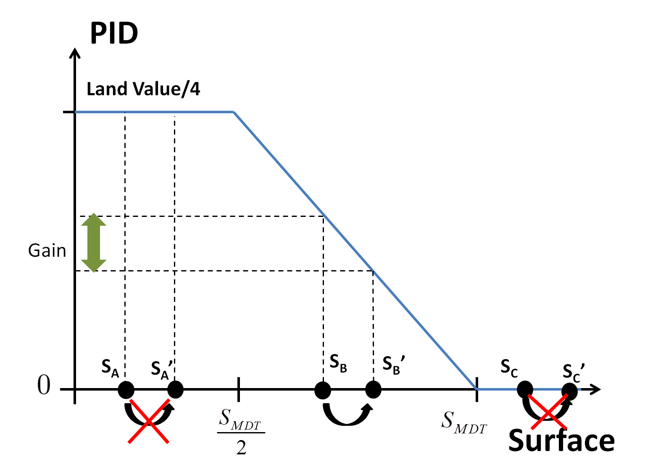
When do we build more?

Slide 6
NEDUM-2D model
Land-use constraints
population density
Rents
Transport times and costs
Total population
Construction costs
Average households income
average dwelling size
floor-area ratio

Slide 7
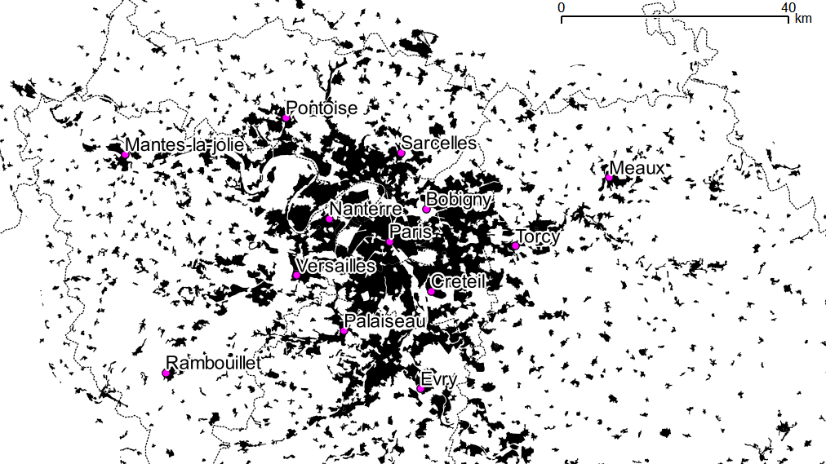
Paris, 2006

Slide 8
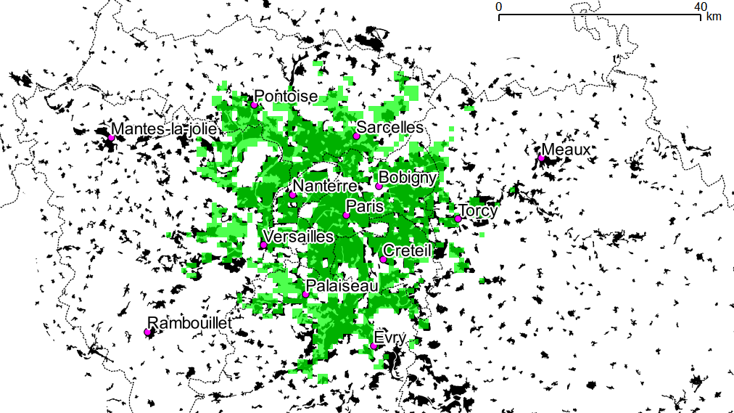
Paris, 2006

Slide 9
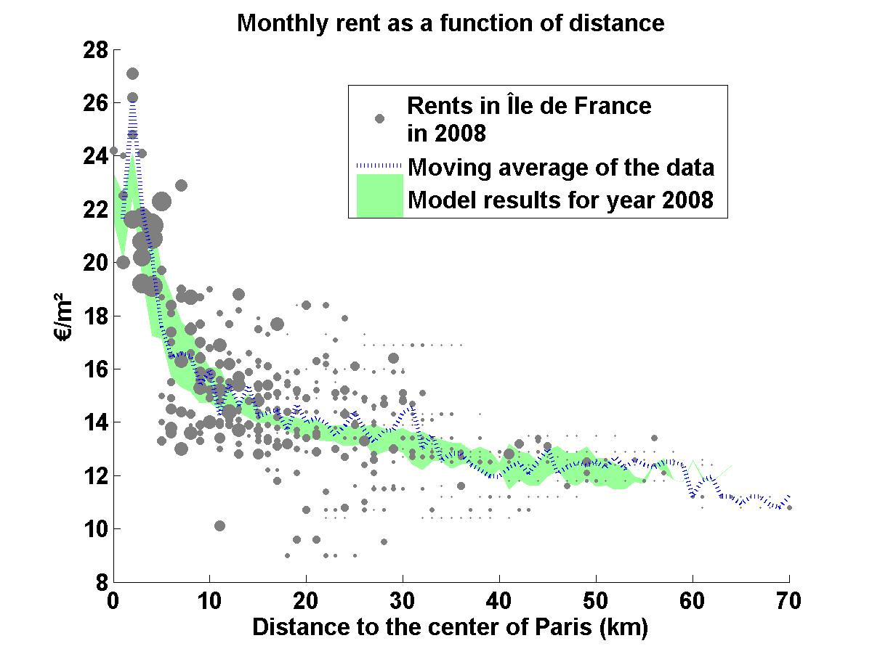
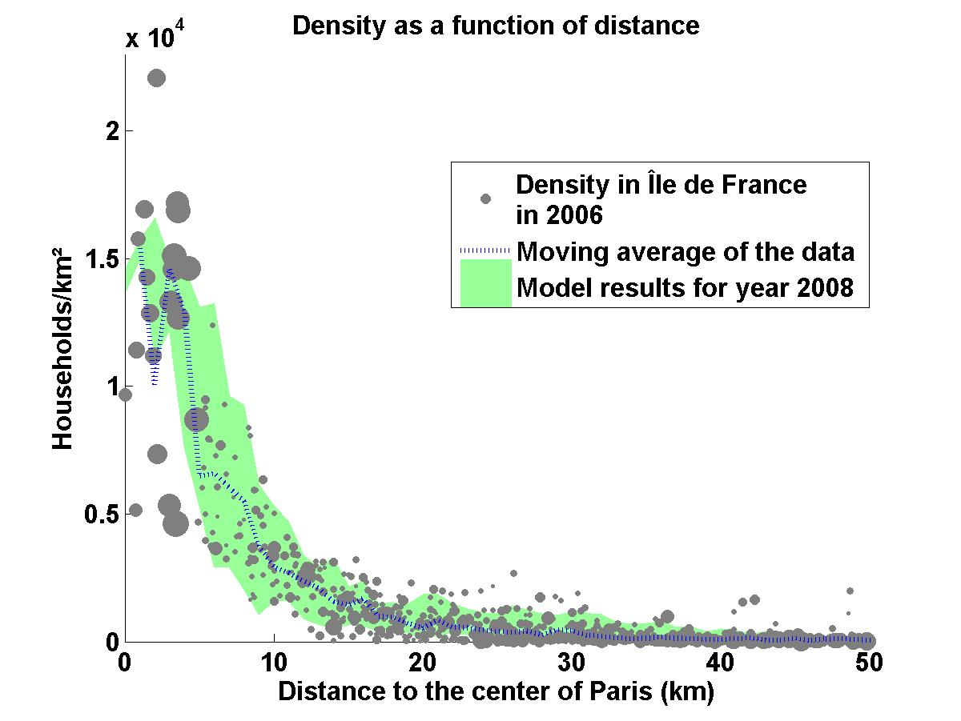
Rents and population density

Slide 10
The exercise we conducted
Prospective simulation of the evolution of the urban area of Paris from 2000 to 2040
Introduction of the PID in 2012
  Definition of a unique MDT…
  That is applied in a homogeneous manner to the whole of the urban area
Comparison of the results with and without PID

Slide 11
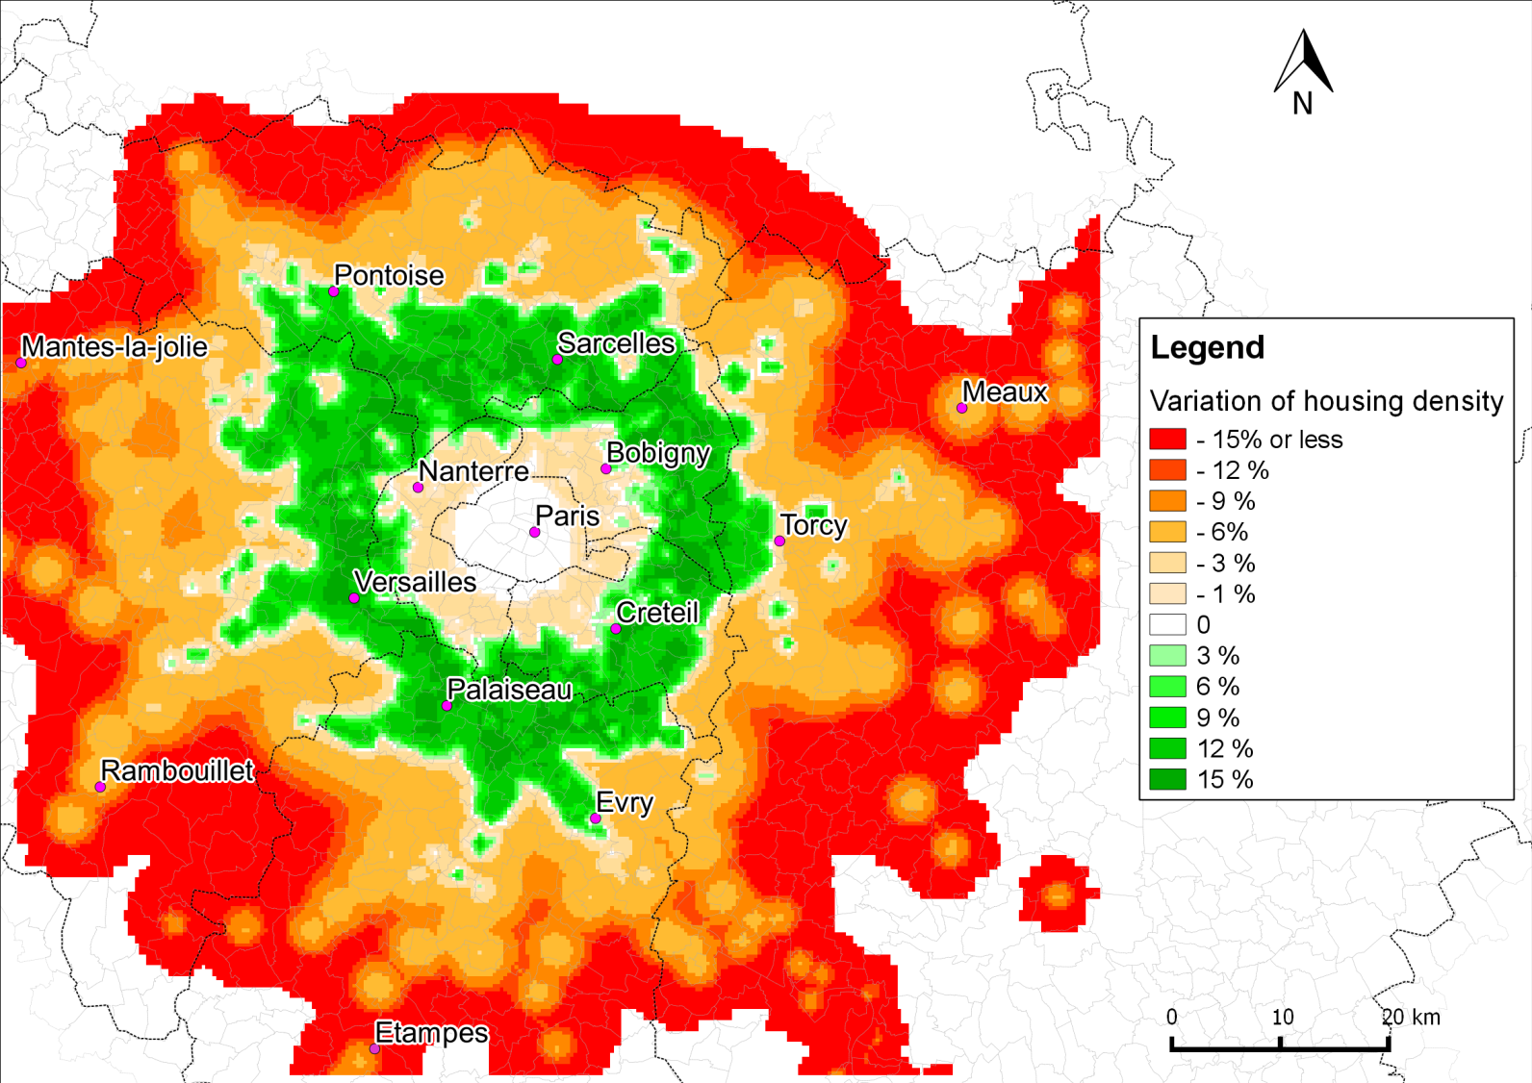
Variation of housing density (MDT: 0.5)

Slide 12
Impacts of the PID: a few numbers (MDT: 0.5)
The PID seems to contribute non marginally to limiting urban sprawl

Slide 13
Impacts of the PID: a few numbers (MDT: 0.5)
The implementation of this tax on construction results in an increase of built m² and thus reduces the rents (or real estate prices) relative to a situation with no PID.

Slide 14
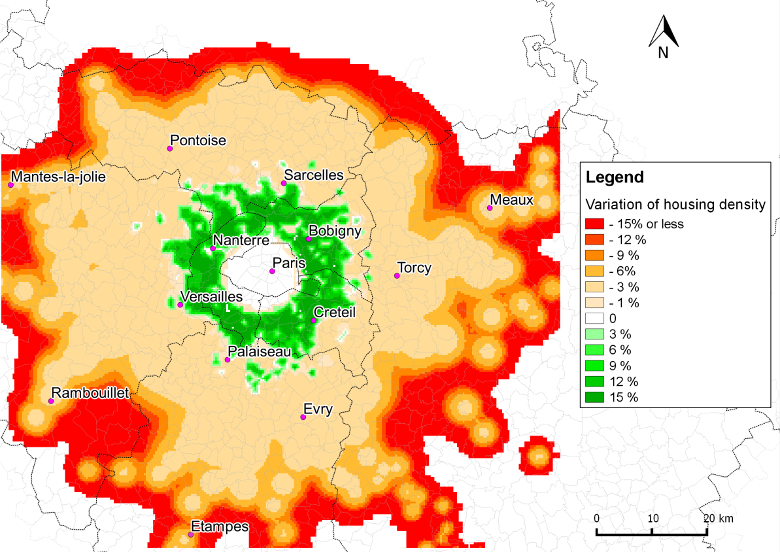
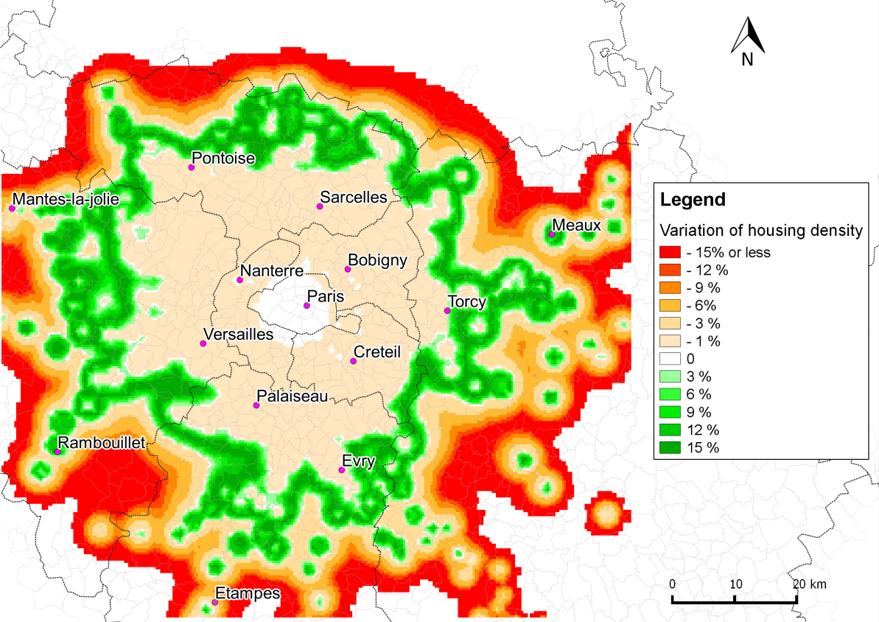
The importance of the Minimum Density Threshold choice
With a MDT of 0.8
With a MDT of 0.2

Slide 15
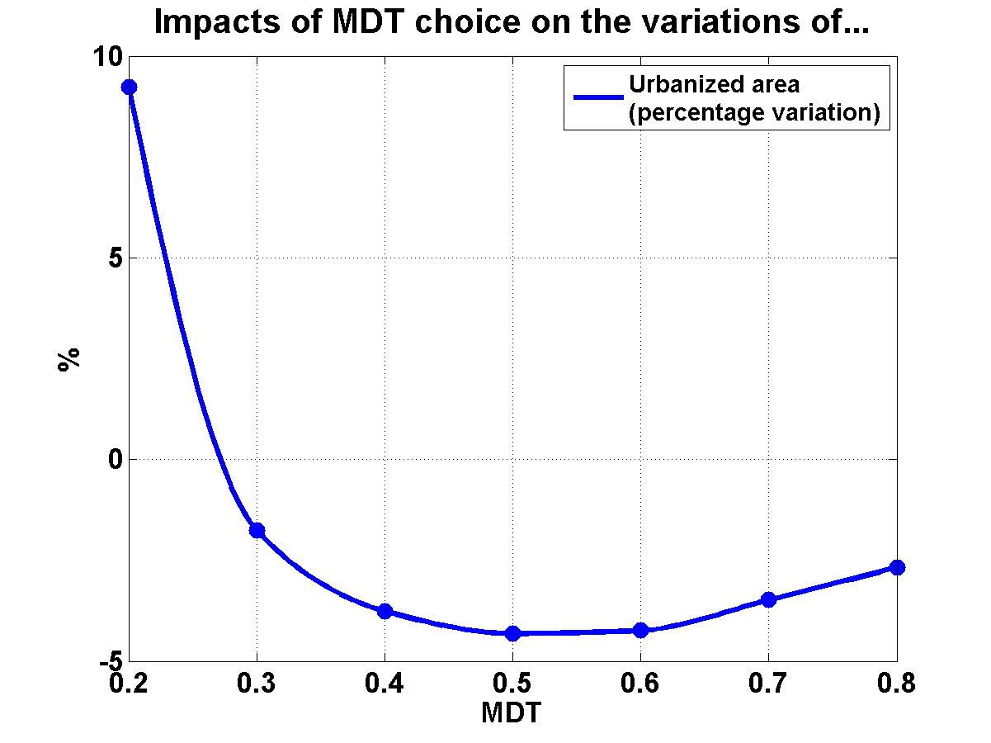
Choice of the minimum density threshold (MDT)
Increase of the urbanized area!!
For MDTs that are too low, the implementation of a PID can prove counter-productive

Slide 16
Choice of the minimum density threshold (MDT)
For MDTs that are too low, the implementation of a PID can prove counter-productive

Slide 17
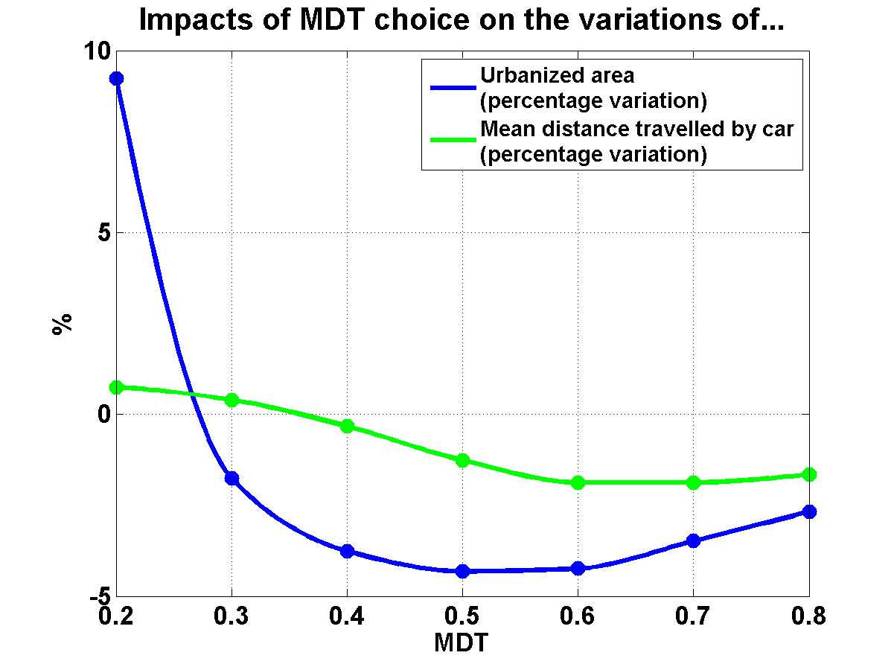
Choice of the minimum density threshold (MDT)
For MDTs that are too low, the implementation of a PID can prove counter-productive

Slide 18
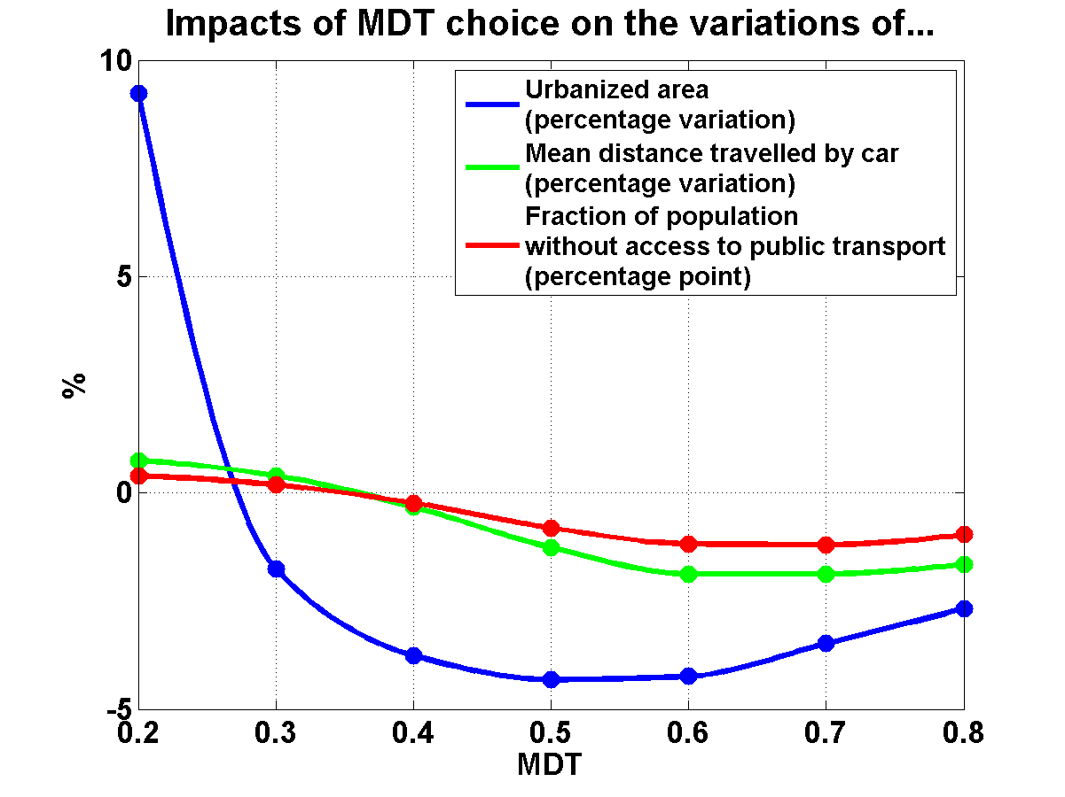
Choice of the minimum density threshold (MDT)
For MDTs that are too low, the implementation of a PID can prove counter-productive
Depending on the criteria retained, the optimal MDT differs

Slide 19
Conclusions
PID is a tax on construction that leads to:
  an increase in built housing surfaces
  limiting urban sprawl
  And does not increase rents (rather lowers them slightly)
The PID is a subtle tool as the MDT that should be chosen varies depending on the objective
  However we supposed a unique MDT that would be applied everywhere in the urban area: not very realistic
Perspectives:
  Modulate the MDT as a function of the distance to public transport stations
  What is the impact of a modification of the PID limit (25% here)?
  What happens when MDT are introduced with no overral coordination??

